Slide 1
Toys4Us an online toy store
Presented by:
Aaron Hossain
Karim Fahd
Sarah Radi

Slide 2
1
The Planning (DELIVERABLE 1)
What we had in mind

Slide 3
How it all started..
ToysRus
CUSTOMIZING MERCHANDISE
IMAGINE ALL THE HAPPY KIDS!
Or all the adults that do not need to be dragged to a physical store
It was fun :>

Slide 4
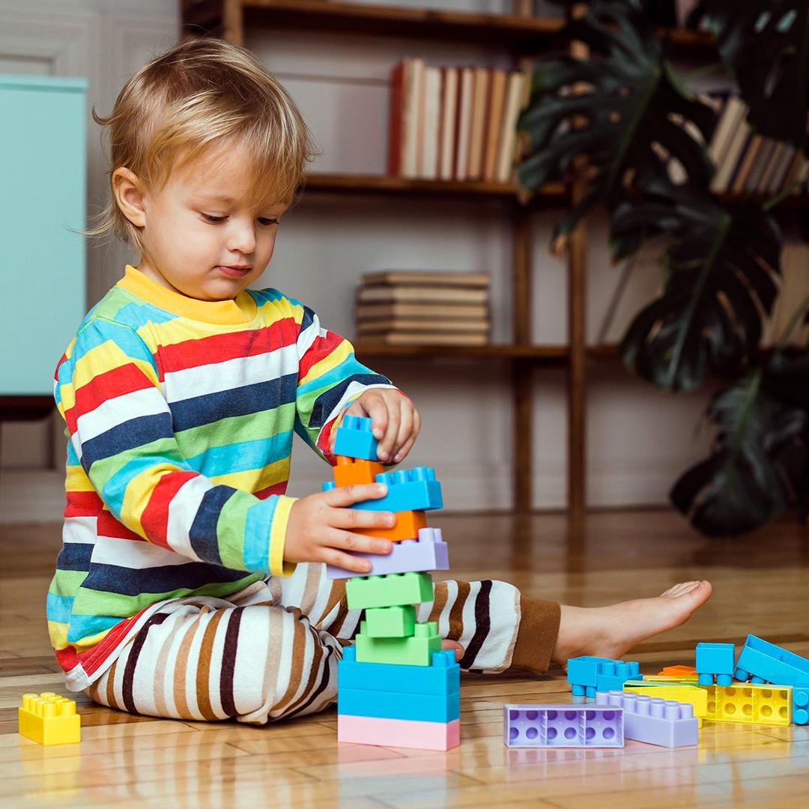
Mockup Stage
We used a base and edited it to fit what we had in mind for out target audience:
Children
Teens
And parents!
It has a simple UI that allows any sort of user to navigate it easily and buy their toys

Slide 5
Friendly UI elements
Simple UI
Friendly Colors
We kept the menus and options as easy and simple to find and clear
Easy on the eyes of the user, brings attention to the products and features

Slide 6
2
The Rough coding (DELIVERABLE 2)
The basic features

Slide 7
What we included
Login
Main pages
Checkout
A splash screen that leads to login page
The main page, the the products page, and the rough build a plush
A checkout page that calculates your total and simulates successful payment

Slide 8
And next up…
The final deliverable

Slide 9
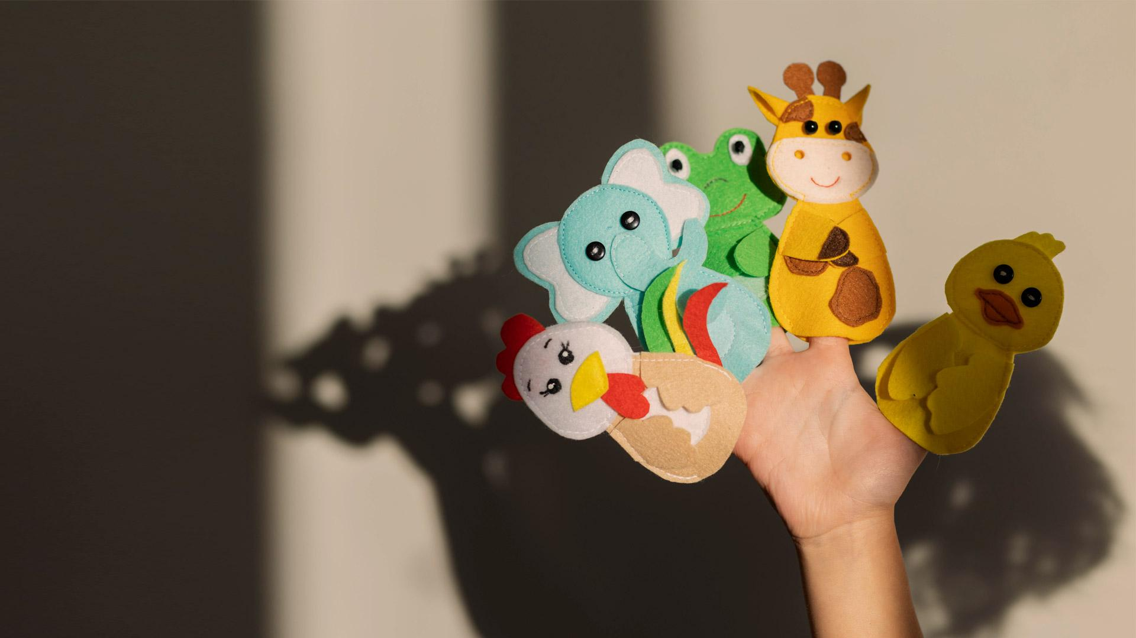
Deliverable 3!
Full implementation

Slide 10
What more?
Build a toy
Stripe
Filters
Store location
Order history
About us and Profile
Completed with full customization
For checkout
For the products page
So you know where to locate the physical thing!
You can now view what you ordered !
For additional information

Slide 11
Our Struggles
Github issues – I had trouble submitting edited files (Sarah)
Trying to find more features to add – (All of us)
The features in question having to take so long to implement (Sarah)
Voice Message and Putting on accessories in build a plush (Aaron)
Implementing google maps APIKey (Aaron)
Stripe not working on Chrome (Karim)

Slide 12
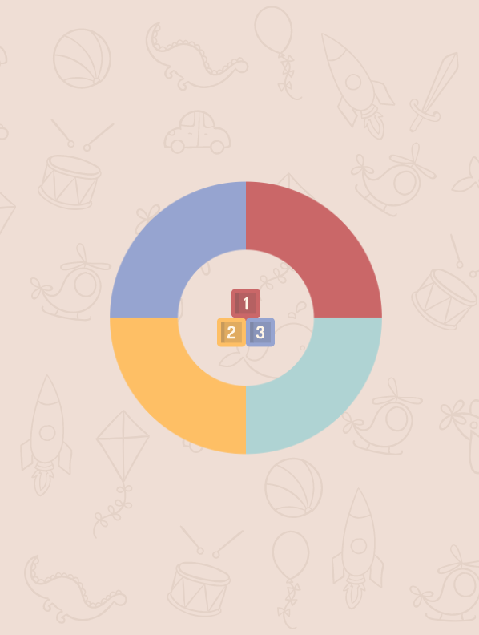
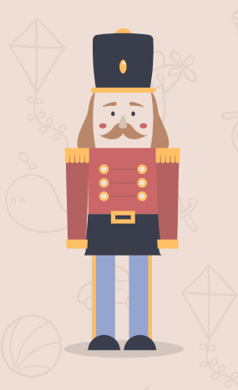
Thank youu
Got any questions? Ask up :>

